Slide 1
Engaging Audiences and Catalyzing Change Through the Arts
An Arts-Based Knowledge Translation Framework for Researchers
Dr. Tiina Kukkonen
Faculty of Education, Queen’s University, Canada

Slide 2
Virtual Meeting/Conference Recording Notice
The American Institutes for Research® (AIR®) allows for the recording of audio, visuals, participants, and other information sent, verbalized, or utilized during business-related meetings. By joining a meeting, you automatically consent to such recordings. Any participant who prefers to participate via audio only should disable their video camera so only their audio will be captured. Video and/or audio recordings of any AIR session shall not be transmitted to an external third party without the permission of AIR.
In addition, AIR does not permit participation in AIR meetings through the use of AI bots such as Otter.ai or other AI platforms to record or transcribe conversations for AIR meetings, webinars, or virtual events in lieu of in-person attendance, unless requested as a reasonable accommodation. Any participants who attempt to use AI software for meeting participation will be denied admission, or their session will be terminated once it becomes apparent such software is in use.

Slide 3

Engaging audiences and Catalyzing Change through the Arts
An Arts-based knowledge translation framework for researchers
Dr. Tiina Kukkonen
Faculty of Education, Queen’s University, Canada

Slide 4
Outline
The potential of art in knowledge translation
Examples of arts-based knowledge translation (ABKT)
An arts-based knowledge translation planning framework for researchers (steps and example)
Considerations for researchers
Possible challenges
Questions

Slide 5
knowledge translation
knowledge exchange
knowledge mobilization
Diffusion of Innovations
Focuses on the uptake of research and evidence into policy, practice, and public opinion
Interactive and nonlinear
Coproduction of knowledge among multiple stakeholders

Slide 6
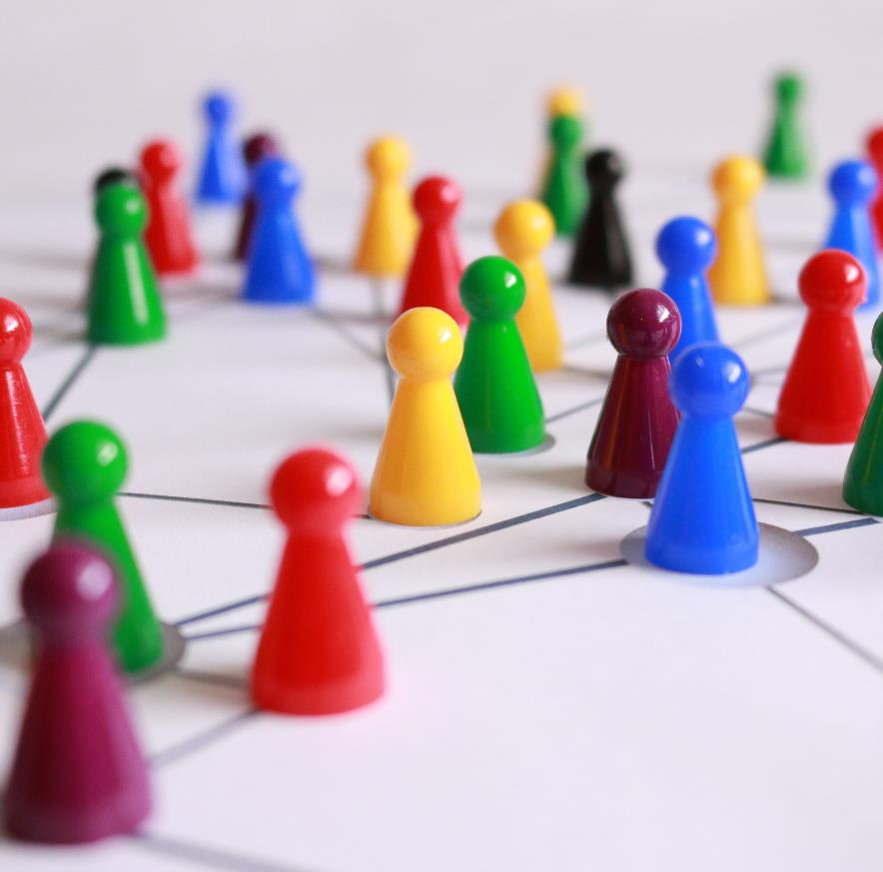
Five Key Steps:
Identify stakeholders.
Involve them early.
Involve them often.
Choose research they can use.
Give them results they can understand.
Source. Smith et al. (2008)

Slide 7
“The arts in general teach us to see, to feel, and indeed to know.”
–Barone and Eisner (2012)

Slide 8
Arts-Based Knowledge Translation
General ideas:
Subfield of KT
Leverages the potential of the arts to reach diverse audiences through multi-sensory and emotional engagement
Increases the accessibility of research and knowledge across cultures and languages
Can occur throughout the research process or at the end
“… a process that uses diverse art genres (visual arts, performing arts, creative writing, multi-media including video and photography) to communicate research with the goal of catalyzing dialogue, awareness, engagement, and advocacy to provide a foundation for social change on important societal issues.”
–Kukkonen and Cooper (2019)

Slide 9
Important Distinctions
Arts-Based Research
ABKT
Art is not simply an add-on to the research process; it is the primary way of examining and understanding experience.
Arts-based research includes art and design elements within both the research process and the research text.
ABKT may or may not include the arts in all steps of the research process.
The arts are used to facilitate the coproduction of knowledge among stakeholders in the KT process.

Slide 10
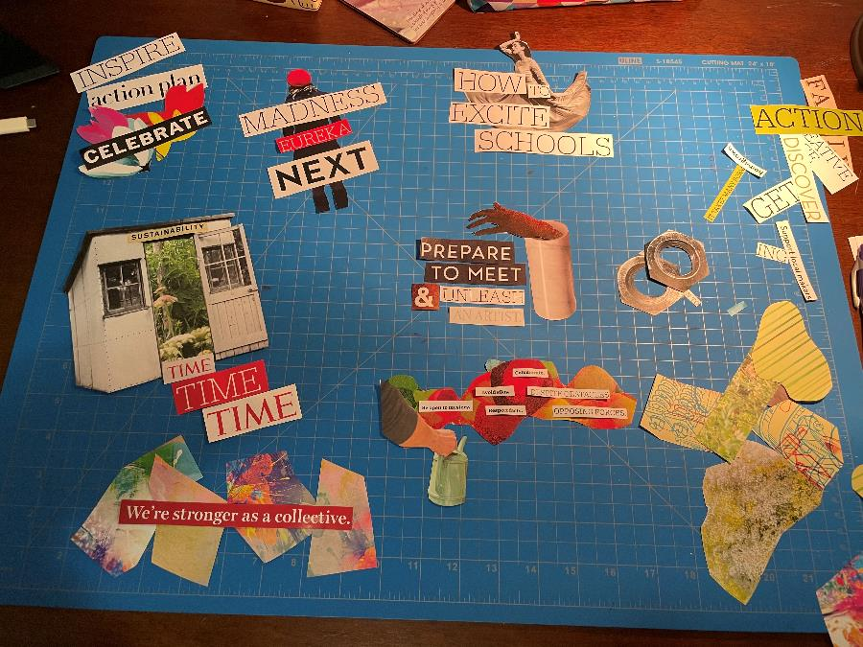
My doctoral research
A cross-case analysis of the roles and functions of five organizations that facilitate partnerships between teaching artists and rural schools
A mix of arts-based research and arts-based knowledge translation
Used collage, digital drawing, and board game design to analyze and understand my data, and then translate the findings to target audiences

Slide 11
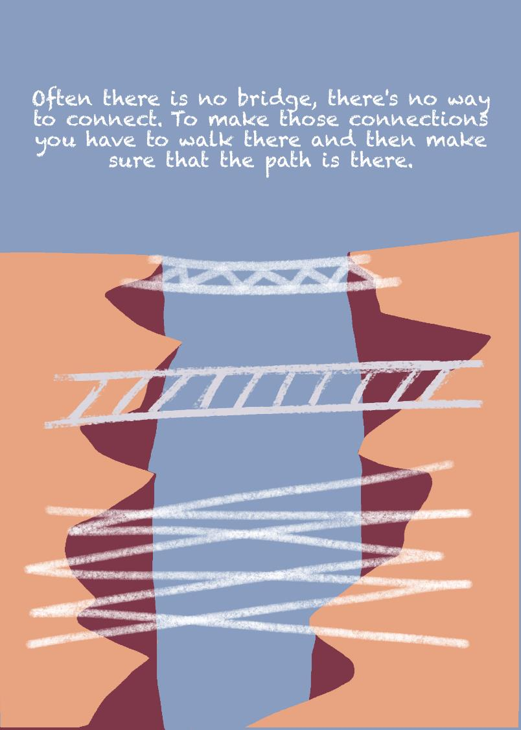
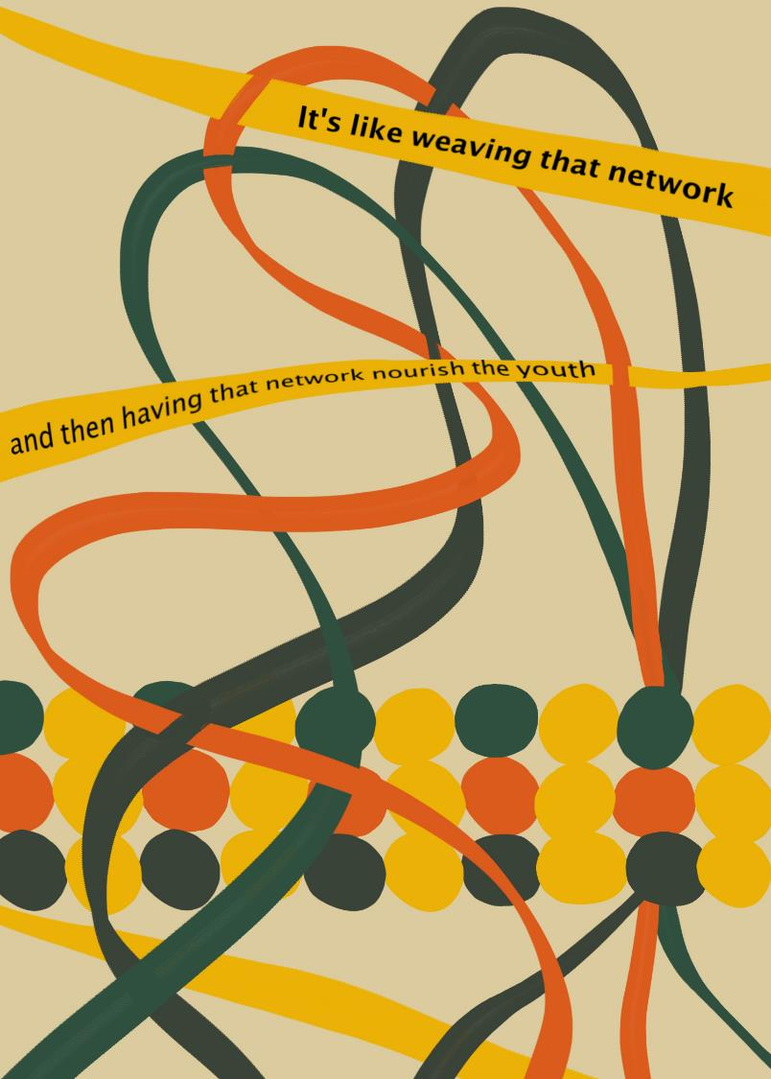

Slide 12
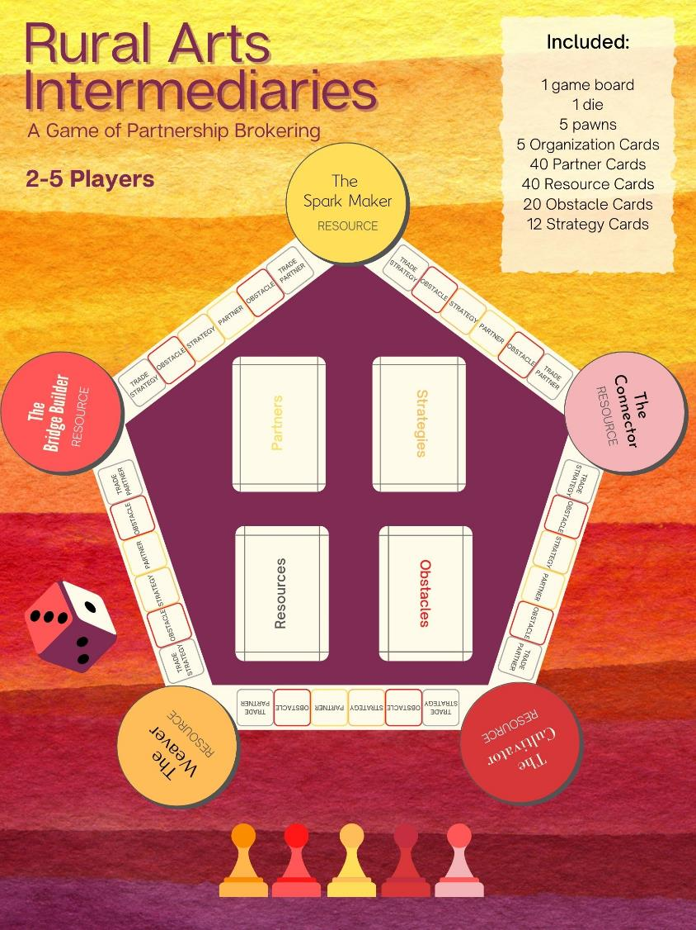

Slide 13
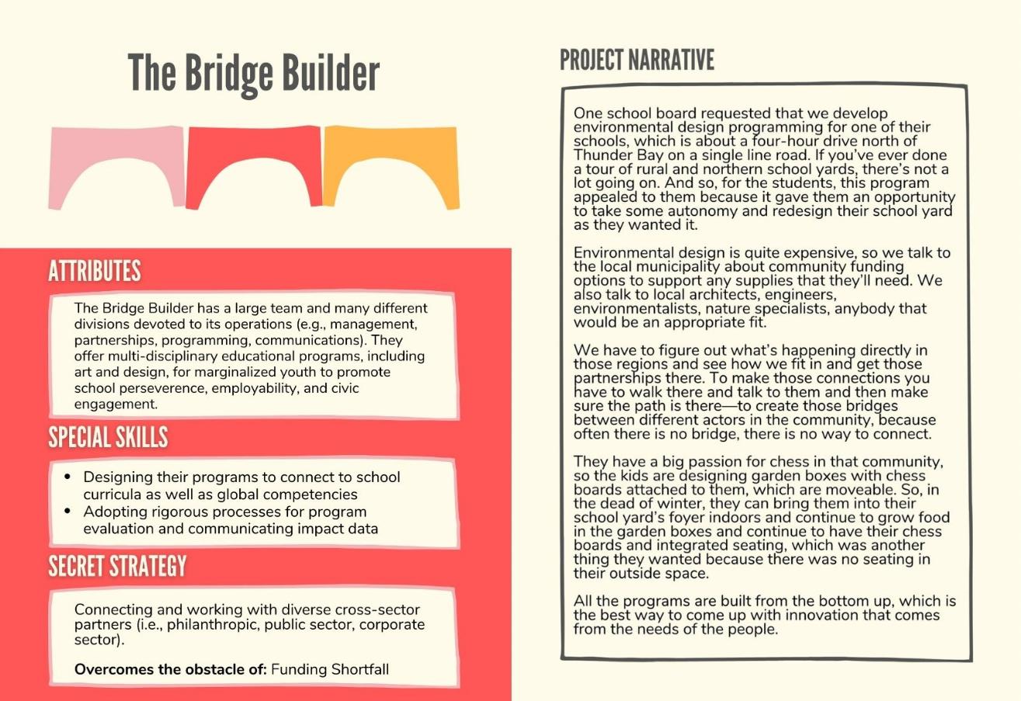

Slide 14
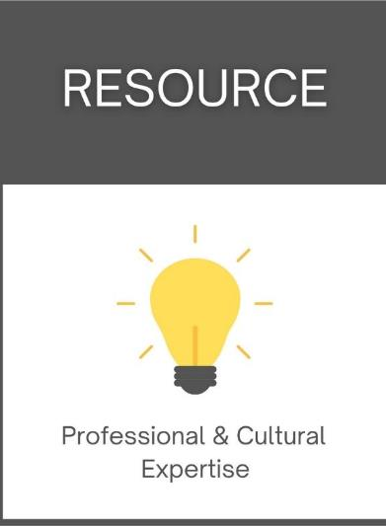
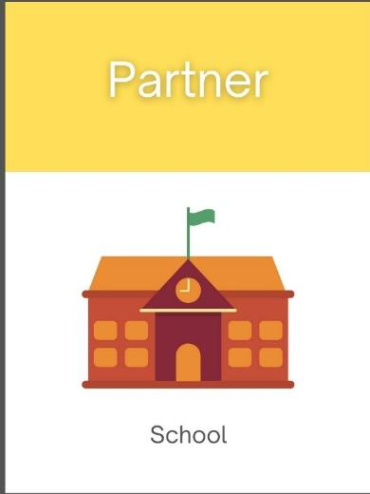
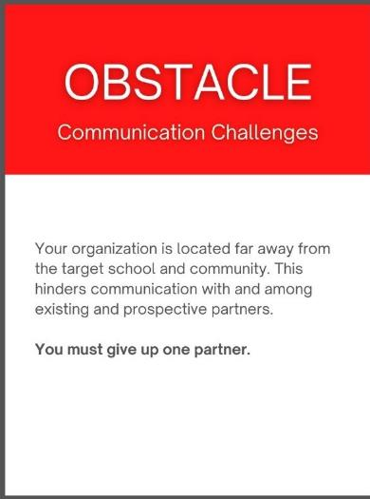
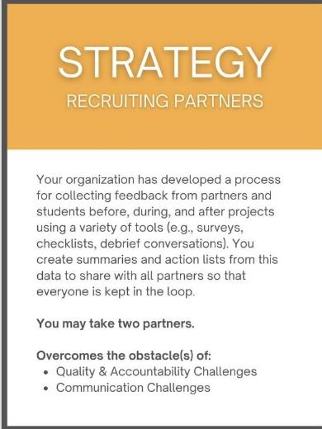

Slide 15
You can access the full game in this Google Drive for free:
https://drive.google.com/drive/folders/1ANiiGzBGaxJABlLV_YmFCJIww9lqSxQp

Slide 16
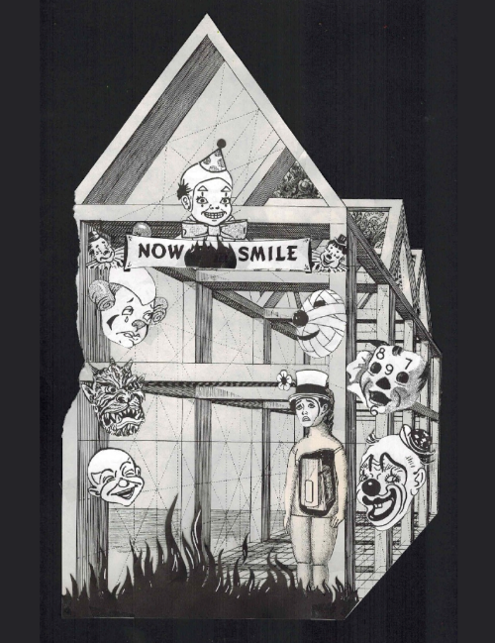
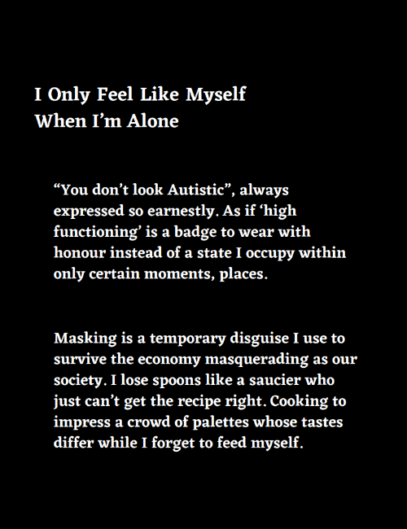
Re•Storying Autism Collective
Dr. Patty Douglas, Queen’s University
A pan-Canadian and international group of 60+ autistic and neurodivergent artists, activists, and graduate students who engage in research creation and community art making to speak back to dominant stereotypes of autism as just a “quirk,” “superpower,” or something to be fixed through remedial therapies.
Vendus Underhill, Autistic Unmasking in the Time of COVID-19
Screen printing and digital printing on paper and velum, hand saddle-stitched
20 pages, 8.5”x11”, 2020-21
Autistic, Surviving and Thriving exhibit, Tangled Art + Disability Gallery, Toronto, 2022

Slide 17
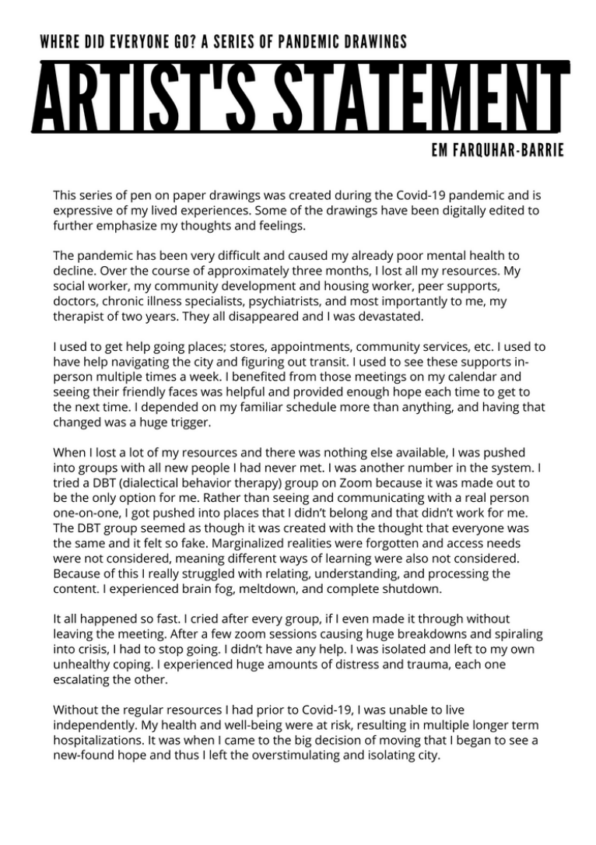
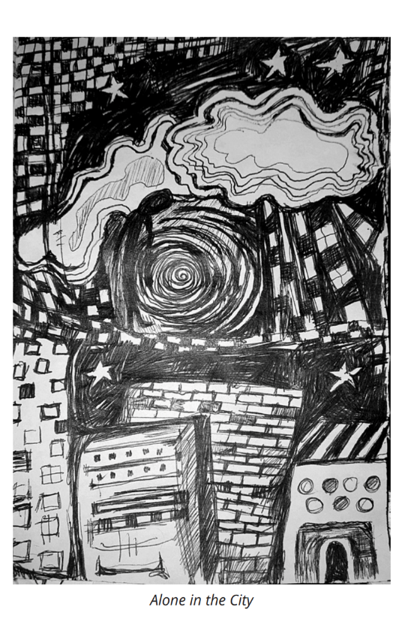
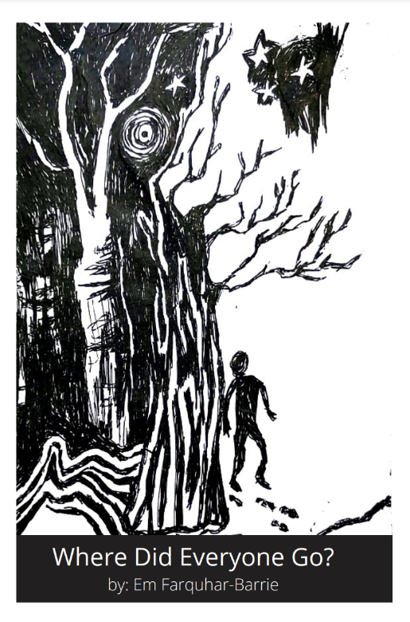
https://www.restoryingautism.com/zines-1

Slide 18
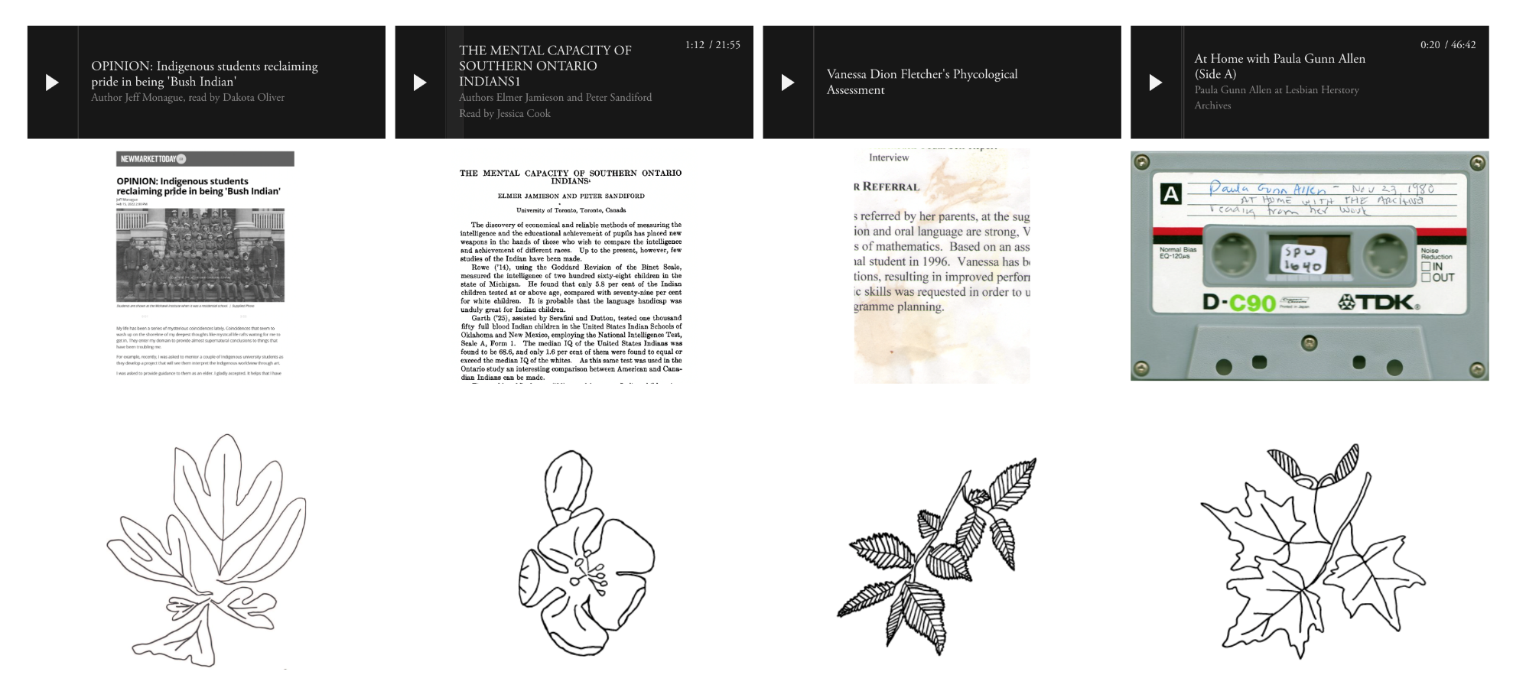
Vanessa Dion Fletcher, a Lenape and Potawatomi neurodivergent artist, created an interactive online exhibit for the Desiring Autism and Neurodivergence symposium, held at Queen’s University in July 2024. The exhibit combines text, audio, and visuals to explore how mental disability has been used to categorize and devalue Indigenous students.
https://dion-fletcher-portfolio.squarespace.com/un-desiring-autism-key-note

Slide 19
Learn more about Re•Storying Autism here:
https://www.restoryingautism.com/

Slide 20
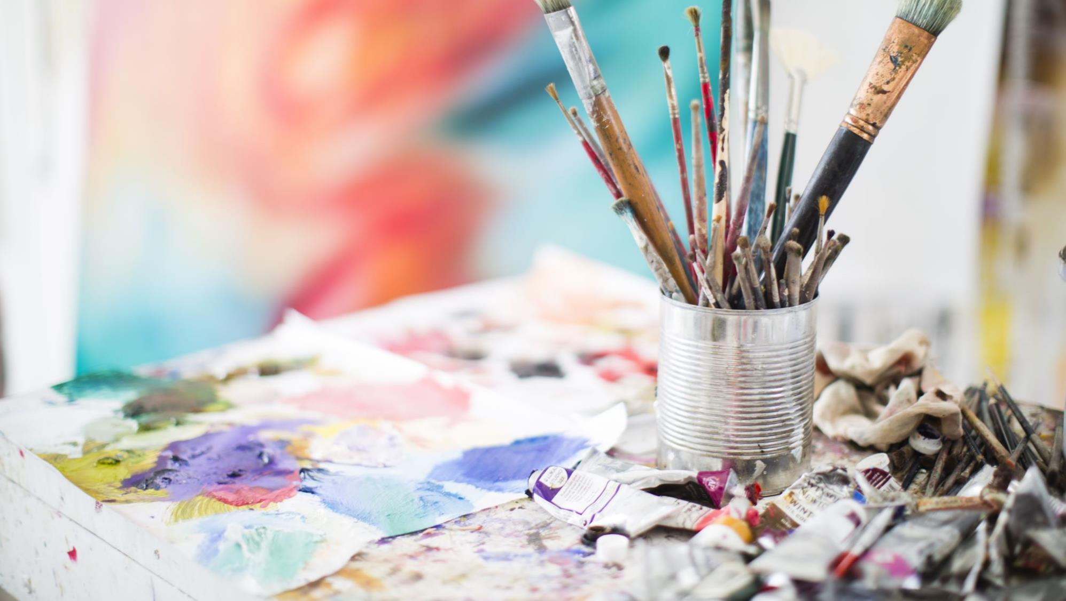
I want to use the arts for KT.
Where/how do I start?

Slide 21
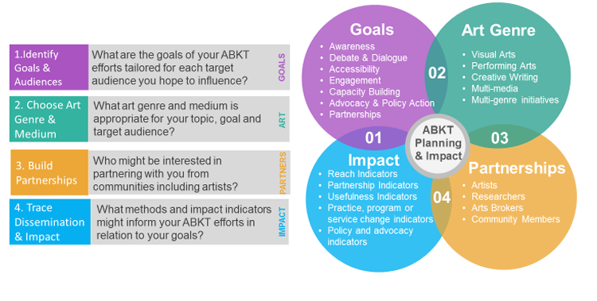
ABKT Planning Framework
Kukkonen, T., & Cooper, A. (2019). An arts-based knowledge translation (ABKT) framework for researchers. Evidence & Policy 15(2), 293–311.

Slide 22
Identifying Goals of ABKT
Source. Kukkonen and Cooper (2019)

Slide 23
Choosing an Art Genre and Forming Partnerships
Art Genre should be consistent with goals and target audience.
Example:
The goal is to promote awareness of mental health concerns and self-care strategies among teenagers.
Would you use…
Slam Poetry B) Song C) Theatre
Who would you need to partner with?

Slide 24
Assessing Impact of ABKT
Source. Kukkonen and Cooper (2019)

Slide 25
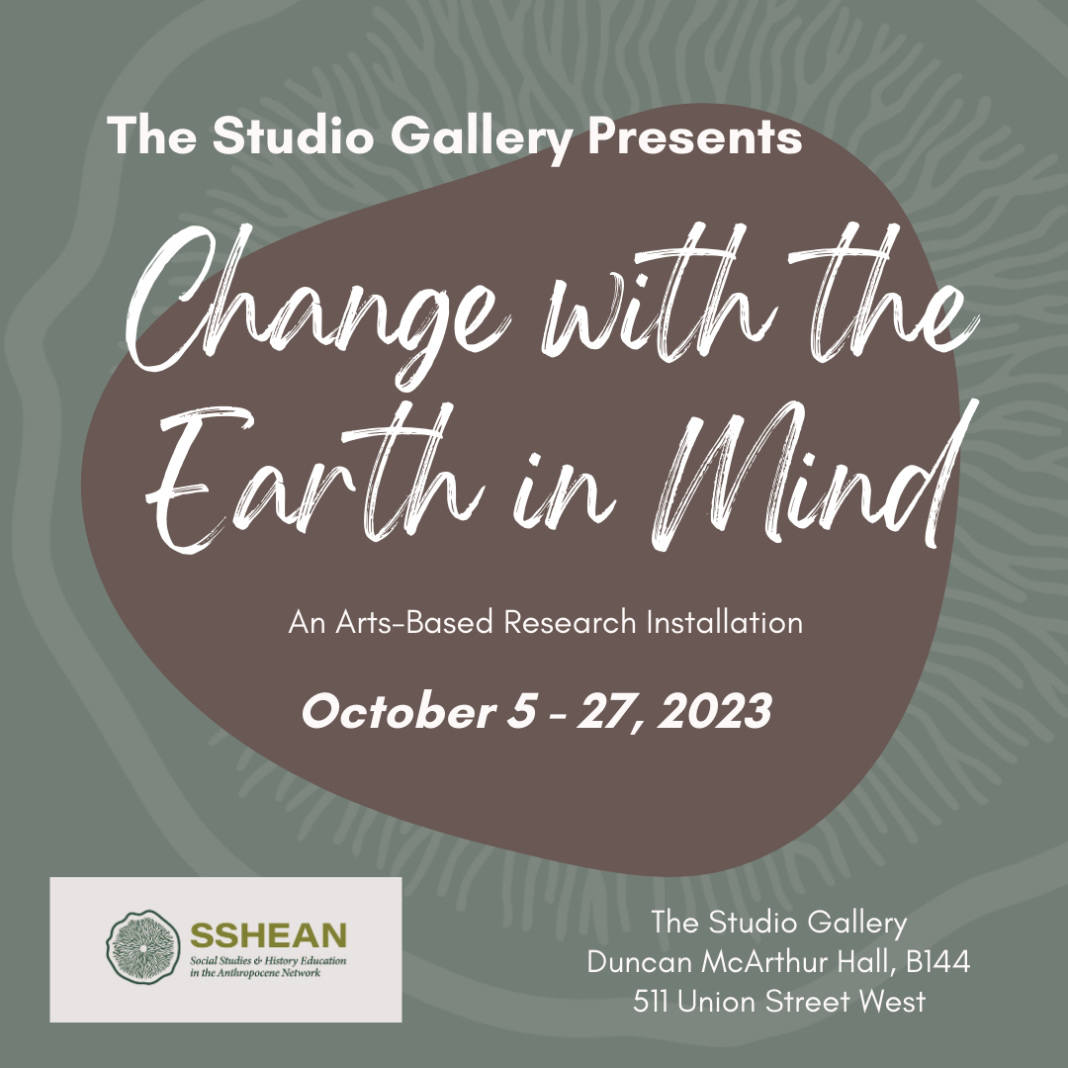
Change with the earth in mind:
A participatory arts-based installation
Dr. Tiina Kukkonen
Dr. Heather E. McGregor
Micah Flavin, MEd student
Faculty of Education
Queen’s University

Slide 26
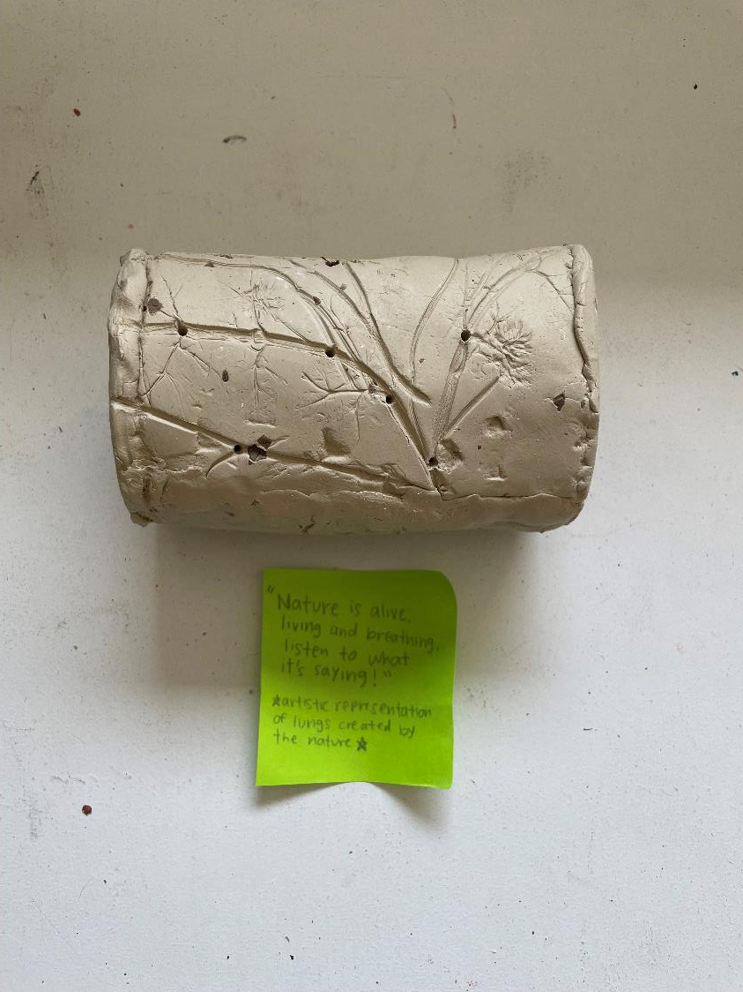
Project Background
We have funds to “artify” research in the Faculty of Education, focusing on partnerships between artists and researchers.
This was the pilot project, where I was the artist working with Dr. Heather McGregor, lead researcher of the Social Studies & History Education in the Anthropocene Network (SSHEAN).
The aim was to find ways to leverage my arts practice to communicate findings or ideas from their research to audiences in our faculty.

Slide 27
Step 1: Identify target goals and audiences.
Three guiding questions:
How do you love the Earth and how does the Earth love you?
What makes you feel ready to change with the Earth in mind?
As you move into an uncertain future, what will you bring with you from the past?
Goal: Increasing awareness of and engagement with issues and topics related to climate change education/action
Target audience: teacher candidates and educational practitioners

Slide 28
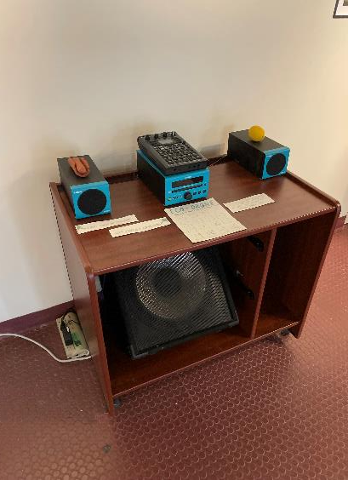
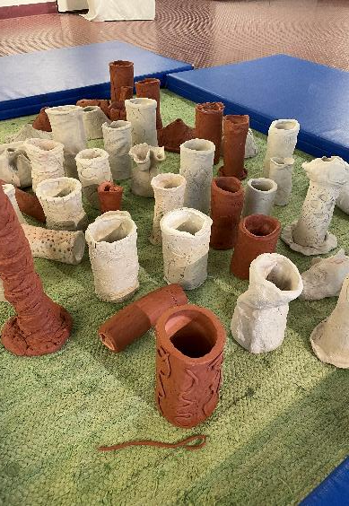
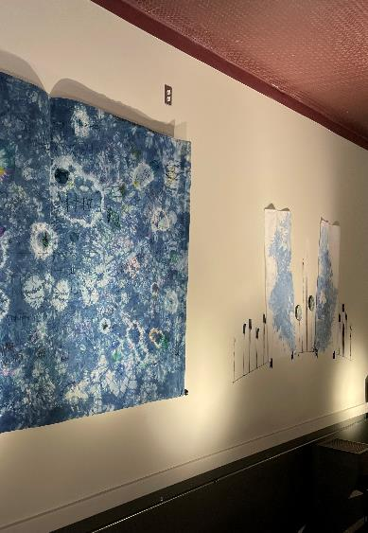
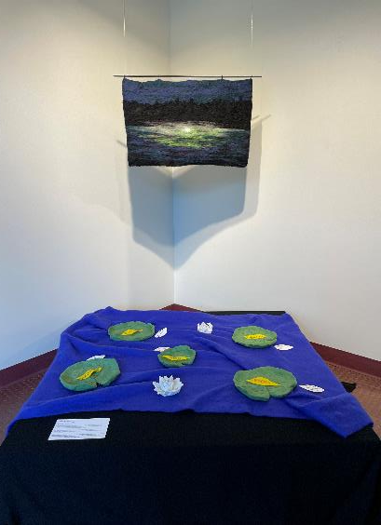
Step 2: Choose art genre(s).
Visual Art: clay, fibre arts (natural materials)
Music/Sound: eco-drone
Multi-Media: public installation

Slide 29
Step 3: Build partnerships.
Partners:
Dr. Tiina Kukkonen (Artist-Researcher-Educator)
Dr. Heather McGregor (Lead Researcher, SSHEAN)
Dr. Amanda Cooper (Associate Dean, Research and Strategic Initiatives) – provided project funding
Dr. Sara Karn (Research Assistant) – helped with conceptualizing the project, clay workshops
Micah Flavin (Grad Student + Musician) – helped with conceptualizing the project, created eco-drone, helped with exhibition set-up and facilitation
Bethany Garner (Local fibre artist) – helped with indigo dyeing, donated materials
Becca Evans (Instructor, PROF 503) + B.Ed. Students – participated in clay workshops
Erin York (Manager of Communications) + Community Initiatives Fund – additional funding and marketing
Soili Kukkonen (Tiina’s mom) – donated fabric, sewed the backing to the mural
Arts Infusion Committee – provided gallery space and exhibition support

Slide 30
Step 4: Trace and measure impact.
Impact Category | Indicators
Reach Indicators: Measure how many people a particular project, performance, or product has reached | Teacher candidates who participated in the clay workshops (n = 53) Gallery visitors (n = 88)
Partnership and Collaboration Indicators: Measure processes of coproduction and dissemination of ABKT with different partners Number of products developed Number and type of capacity-building efforts Engagement of stakeholders | Clay-making workshops (n = 2) Collaborative mural-making activity (n = 1) Installation consisting of 53 clay “listening devices,” 1 eco-drone, 1 fabric mural, 1 felt artwork, 5 clay lily pads Journal articles (n = 2) Conference presentations (n = 2) Informal observations of audience engagement
Usefulness indicators: Measure whether a target audience found the ABKT products useful | Guestbook comments: “beautiful” “peaceful” “moving” “inspiring”

Slide 31
Some Reflections From the Core Team
HEATHER
Researcher, SSHEAN team leader
Super keen to collaborate, but unsure about process, artist expectations, and terms of collaboration
Motivated by the opportunity to try a different approach to research work and KMb
Importance of involving entire research team and inviting Tiina to be part of the team
TIINA
Artist-researcher
Motivated to explore new approaches to KMb, integrating my own artistic practice, and learning about a different research area
Navigating the pressure to “make something” as an artist
Drawing on the essence of SSHEAN to inform the process (participatory, open-ended)
Involving the target audience in the creation of artworks
MICAH
Artist, graduate student, SSHEAN member
Interested in the process of asking important questions with a community of people, rather than alone
Understanding sound as a holding and tying element – holding and tying together people and the gallery space
Giving people a space to rest was important – impacted the design of the installation
Connections to experiential education

Slide 32
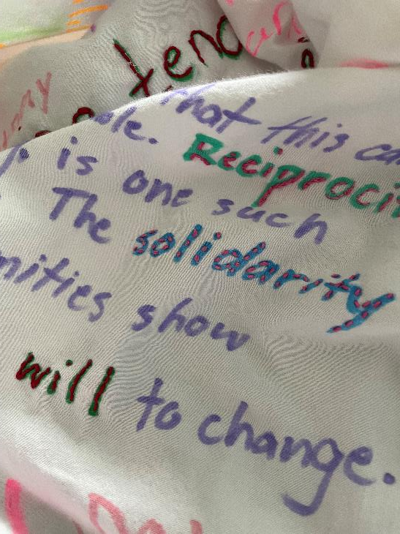
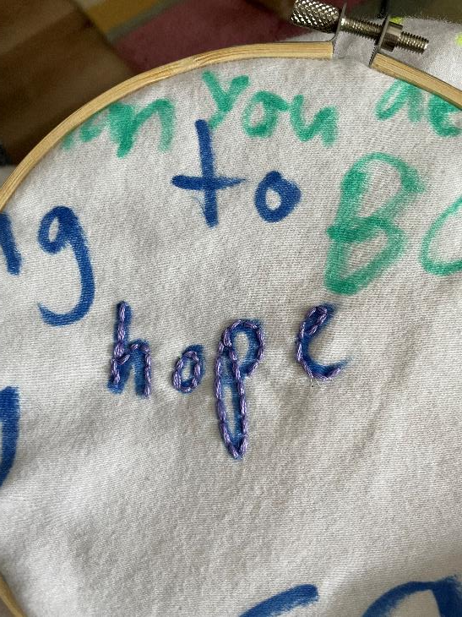
Unexpected Extensions/Outcomes
Embroidery as data analysis

Slide 33
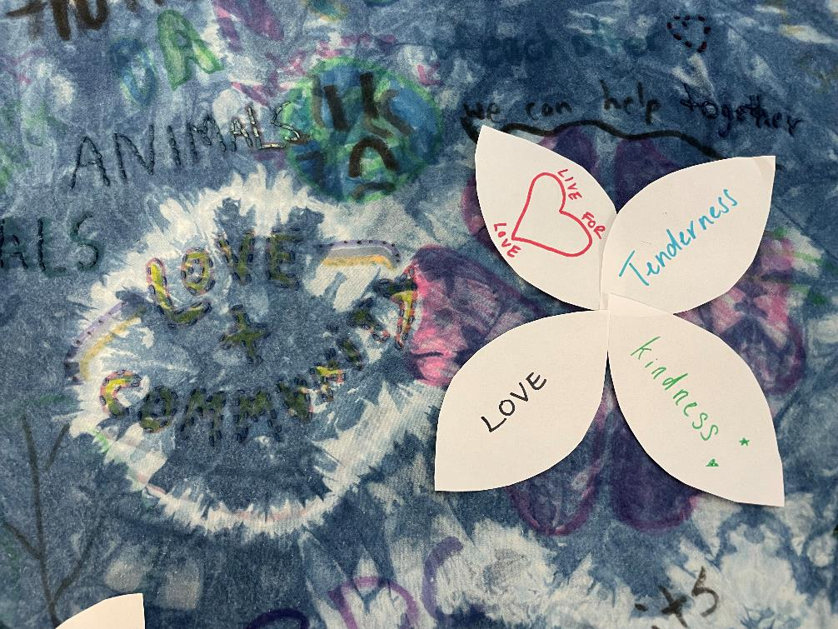
Unexpected Extensions/Outcomes
Connecting themes across participatory art pieces

Slide 34
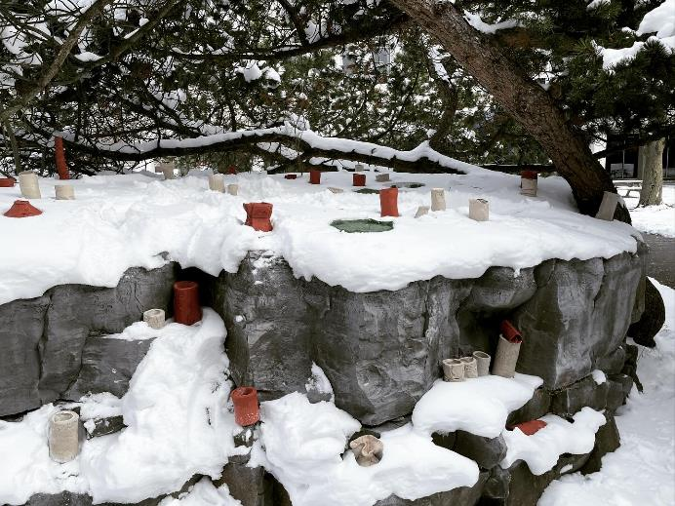
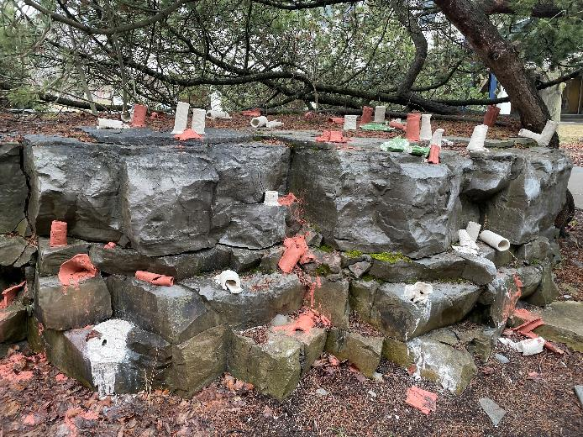
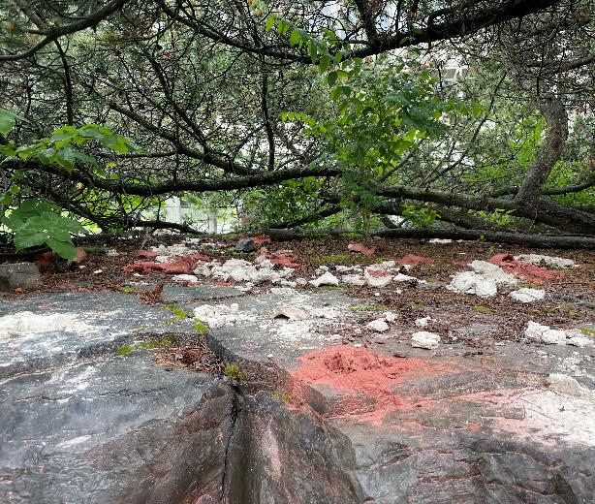
Unexpected Extensions/Outcomes
Returning clay back to the Earth/process of decay

Slide 35
Read more about our project here:
https://sshean.ca/research/art-for-the-anthropocene/

Slide 36
Considerations for Researchers
Things to consider (based on what we’ve learned)…
Knowing how each key partner thinks/works (e.g., artist understanding research, researcher understanding art)
Having team members who wear all the hats (artist-educator-researcher) makes things easier—but this might not be the case in all partnerships
Being open to the unexpected (especially when leaving art out in public spaces)
The importance of carefully crafted questions and goals to connect with and engage people
Considering the intersections between art and research practices to find common ground and new pathways forward

Slide 37
Possible Challenges
Quality control and artistic integrity
Assumptions of art and art-making
Clarity and reach of message
Gathering impact data

Slide 38

Questions
How might ABKT be useful in your context?
What challenges do you foresee?
How might we bridge the gap between artists, researchers, and other stakeholders in this process?

Slide 39
Thank you!
Feel free to reach out!
Dr. Tiina Kukkonen
tiina.kukkonen@queensu.ca
Dr. Patty Douglas
douglas.patricia@queensu.ca

Slide 40
References
Barone, T., & Eisner, E. W. (2012). Arts based research. SAGE.
Kukkonen, T., & Cooper, A. (2019). An arts-based knowledge translation (ABKT) planning framework for researchers. Evidence & Policy, 15(2), 293–311.
Smith, F. M., Muhajarine, N., Vu, L., Smith, J. A., Delanoy, S., & Ellis, J. (2008). Building partnerships to improve children’s health. In the Canadian Institutes of Health Research, Knowledge to action: A knowledge translation casebook (pp. 1– 4). Ottawa, ON: Canadian Institutes of Health Research.

Slide 41
Evaluation
Please help us by filling out the online evaluation here:
https://survey.alchemer.com/s3/8085500/Evaluation-Webcast-88-ABKT

